Slide 1
GAMECO MARKET SALES ANALYSIS
Presented by Uijin Hwang

Slide 2

GOAL:
Develop an understanding of the video game market sales to help
GameCo plan the marketing budget for 2017.
CURRENT Expectation:
GameCo’s current understanding around video game sales assumes that
sales across regions have stayed the same over the years.
AREAS OF FOCUS
This analysis will observe trends over time for the below observations:
Sales trends
Top genres
Top publishers

Slide 3
SALES TRENDS
North America has dominated the market in sales since 1996
There have been an explosive growth in sales from 2005 to 2010.
Sales peaked in the late 2000s, 2008 for North America, 2009 for Europe, and 2006 for Japan.
Since 2008, there are a significant decline in sales of video games, which can be attributed to the introduction of digital sales.

Slide 4
PROPORTION OF REGIONAL SALES
From 1997 to 2015, North America shows a dominantly high sales in Global market but a declining share at the rate of 2-4% every year.
Europe and Other regions show a steady incline in sales.
On 2016, Europe finally surpasses North America by gaining the largest market share.
Since 1997, Japan owns third largest market, proving to be competent with annual growth of 1-2%.

Slide 5
GENRE POPULARITY
North America, Europe, and Other regions share the same top 3 genres: Action, Sports, & Shooter
Japan’s top genre is role-playing, followed by Action & Sports.
So top 4 genres global are Action, Sports, Shooter & Role-playing.

Slide 6
GANRE SALES
Top 4 genre sales show a drastic increase in sales up until 2009.
As shown above, the decline in sales can be attributed to the increase of digital sales, which started on 2009.

Slide 7

TOP PUBLISHERS
Nintendo, Electronic Arts, Activision are the most popular publishers in most of the regions except Japan.
Nintendo is the top publisher in North America, Europe, Japan and the second in other regions.

Slide 8
PUBLISHERS SALES
Top 4 publishers sales show a gradual decrease since 2006.
In 2010, Nintendo lost more than 50% of its business from the previous year.
As shown above, the decline in sales can be attributed to the increase of digital sales, which started on 2009.

Slide 9
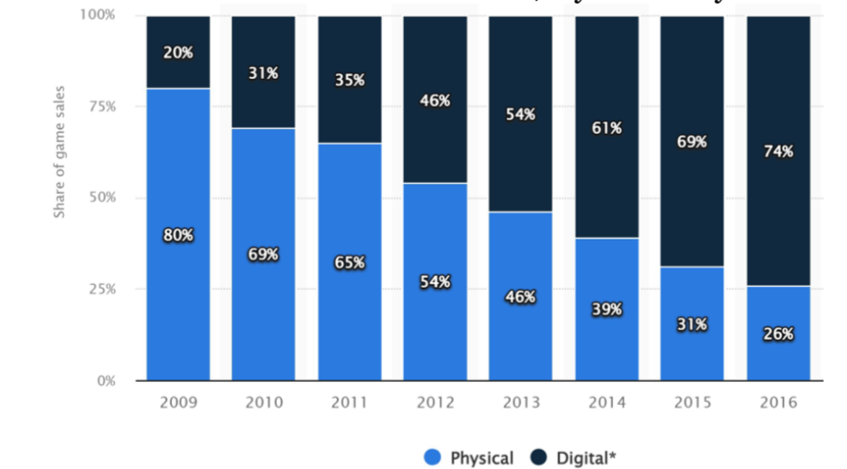
GAME SALES BY DELIVERY FORMAT IN THE USA
This graph clearly shows the trend how the physical sale has been gradually declining since 2009 but the digital sale has been gaining in the US and possible in North America overall.
Source: https://www.statista.com/statistics/190225/digital-and-physical-game-sales-in-the-us-since-2009/

Slide 10
New Market Understandings
According to GameCo’s sales data, there is a significant decline of sales in North America since 2008
However, Europe and Other show a steady increase in the sales of video games in recent years.
North America, Europe, and Other regions share the top 3 popular genres: Action, Sports, & Shooter
Nintendo dominates the market in all regions except Other regions.
The decline in GameCo’s sales might be attributed to the fact that digital sales have become increasingly popular globally since 2008.

Slide 11
Recommendations
Following the sales data, it looks like GameCo needs to decrease marketing budget to the downfallen North America and increasing toward Europe.
This might be misleading due to the lack of data on digital sales in GameCo. The digital sales have substantially grown worldwide, since 2009. As the previous data shows, in the USA, only 20% purchased games digitally on 2009 but digital sales are about 74% on 2016.
North America has ever the highest internet usage worldwide and the trend of digital purchases is continuing in this region (trend-setter).
This trend will not be changing and it will affect globally, which means the trend of digital purchases is continuing and its share will be growing.
Further analysis should be conducted to determine if the introduction of digital sales really attributed to the decline of GameCo’s sales.
GameCo should plan for a platform in which it can sell the games digitally.
Make sure to provide popular game genres for each region as the best marketing strategy.
For 2017, partnering with Nintendo as the top publisher will give the highest marketing value for the release of the games.

